Slide 1


OTTO Engineering, Inc.
AS9102 First Article Inspections:
Requirements and Expectations
101223
Company XYZ noting on their CoC to OTTO, the Job, Batch or PO # that pertains
Confidential

Slide 2
General Information
Presenter introduction
Webinar is being recorded…available on the OTTO website late Oct
Attendees’ microphones are muted to help keep us on schedule
Please use the chat function for questions/comments
  Questions will be addressed as time allows and/or in the webinar posting
Additional webinars planned for this year…details to follow
Contact OTTO Supplier Quality at supplierquality@ottoexcellence.com with questions/clarification on any webinar and/or AS9102 requirements

Slide 3
Agenda
AS9102 First Article Inspection (FAI) Requirements
Defined
Purpose
Application
When required
  Supplier (OTTO Tier 1s…holder of OTTO PO) flow‐down to sub-tiers
Submission
  AS9102 FAI Report contents
  How and where to submit

Slide 4
AS9102 First Article Inspection (FAI) Requirements
Defined
AS9102 First Article Inspection
  First piece - first item made to prove a process (typically made at the beginning of a shift, run etc.)…focus is dimensional conformance
    Machining
    Molding
    Plating
  First article – single or several components which result from a few/several processes
    Molded component that includes paint and pad printing
    Assembly
    Finished Good

Slide 5
AS9102 First Article Inspection (FAI) Requirements
Defined
AS9102 First Article Inspection
  Detailed process for manufacturers and customers to capture product requirements, inspect and document all product features and the materials and processes used in the manufacture of the part, product or assembly
  Primarily used by the aerospace and defense industries
  Certifies that each sample was produced and inspected according to customer specifications
  Three required forms: Part Number Accountability, Product Accountability, and Characteristic Accountability

Slide 6
AS9102 First Article Inspection (FAI) Requirements
Purpose
Verify and validate processes are capable of producing characteristics that meet engineering and design requirements
Provide raw material traceability from producer to customer (i.e., OTTO)
Provides objective evidence, the product realization processes are capable of producing conforming product
Demonstrates manufacturers and processors of the product have an understanding of requirements
Provides assurance of product conformance at the start of production and after changes

Slide 7
AS9102 First Article Inspection (FAI) Requirements
Application
Parts and product used in aerospace or defense industries
Organizations responsible for processes that produce the design characteristics of the product
Req’mt imposed by OTTO’s customer…AS9102 FAI becomes a req’mt for OTTO’s suppliers

Slide 8
AS9102 First Article Inspection (FAI) Requirements
Application
AS9102 applies to assemblies, sub-assemblies, and detail parts including castings, forgings, and modified standard catalog or Commercial-Off-the-Shelf (COTS) items
  Each of these items shall have a separate FAI
Exceptions
  Unless specifically noted on the OTTO PO (code Q100) AS9102s are not required for:
    R&D and prototype parts that are not considered as part of the first production run
    Standard catalog and COTS items
      If included in an assembly, standard catalog and COTS items shall be listed in the index of part numbers on AS9102 Form 1, but FAIs are not required

Slide 9
AS9102 First Article Inspection (FAI) Requirements
When Required
New production part or product
Design change (new part number or revision)
Manufacturing process change (includes outside/secondary processes)
  New/different supplier
  New/different inspection method(s)
  New/different/revised tooling…Does not include tooling PM
  New/different material…Does not include new batch/lot/heat numbers
  Change in manufacturing location
Lapse in production > 2 years
  Determine from the completion of the last production operation to the actual restart of ‘new’ production
Correction of a discrepancy on a previously submitted part/FAI
OTTO request
When applicable, OTTO Tier 1 suppliers must flow‐down FAI requirements to their sub-tiers
Notes:
Rev change and no impact FAIs

Slide 10
AS9102 First Article Inspection (FAI) Requirements
Submission - FAI Report packet contents
Ballooned drawing
AS9102 forms (3 total)
Raw material certs
Process certs…as applicable
Test data/results…as applicable
Waivers, deviations…as applicable

Slide 11
AS9102 First Article Inspection (FAI) Requirements
Submission - FAI Report packet contents
Ballooned Drawing
  Drawing that contains numbered “balloons” that point to individual dimensions and requirements (i.e., notes, material, process, etc.) for the part
  The balloon numbers on the drawing correlate with the item or characteristic numbers found on the Dimensional/Inspection Data Sheet…AS9102 Form 3
AS9102 forms
Raw material certs
Process certs…as applicable
Test data/results…as applicable
Waivers, deviations…as applicable

Slide 12
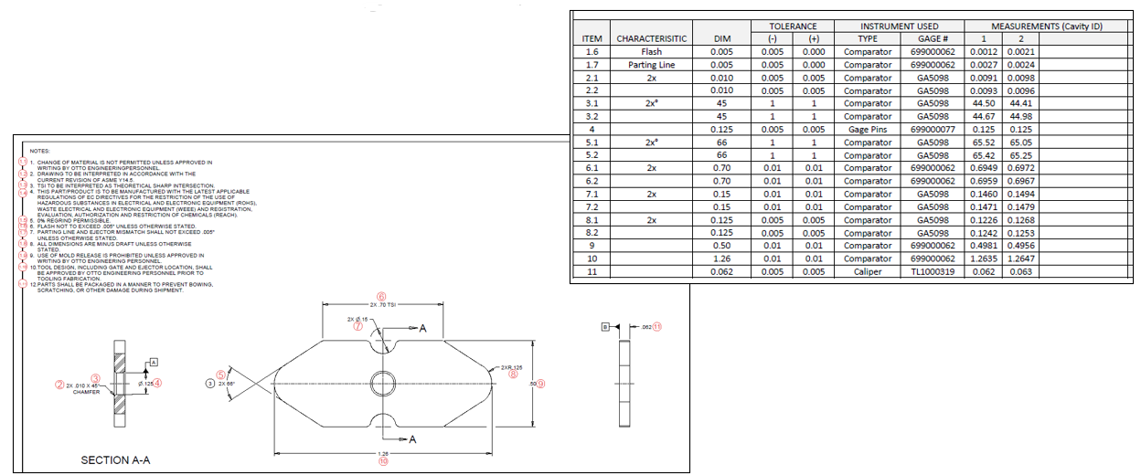
AS9102 First Article Inspection (FAI) Requirements
Ballooned Drawing - Example

Slide 13
AS9102 First Article Inspection (FAI) Requirements
Submission - FAI Report packet contents
Ballooned Drawing
AS9102 Forms
  FORM 1 - PART NUMBER ACCOUNTABILITY
  FORM 2 - PRODUCT ACCOUNTABILITY - MATERIALS, SPECIAL PROCESSES, AND FUNCTIONAL TESTING
  FORM 3 - CHARACTERISTIC ACCOUNTABILITY, VERIFICATION, AND COMPATIBILITY EVALUATION
Raw material certs
Process certs…as applicable
Test data/results…as applicable
Waivers, deviations…as applicable

Slide 14
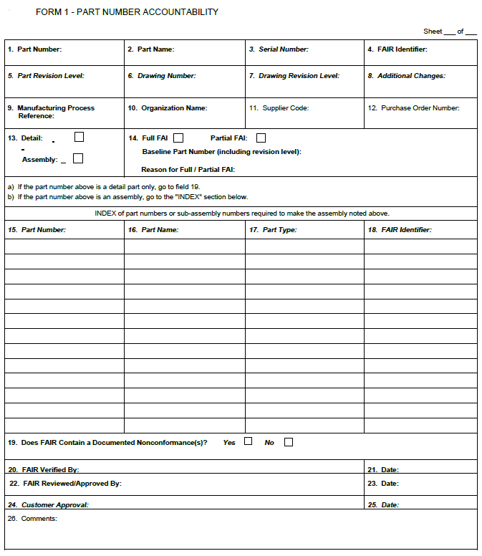
AS9102 First Article Inspection (FAI) Requirements
Submission - FAI Report packet contents
AS9102 Forms
  FORM 1 - PART NUMBER ACCOUNTABILITY
    Box 1 thru 14, 19 thru 23 and 26…always required
    Box 15 thru 18…required for assemblies
Notes:
Box 15 thru 18 – applicable when FAI pertains to an assy…otherwise enter NA

Slide 15
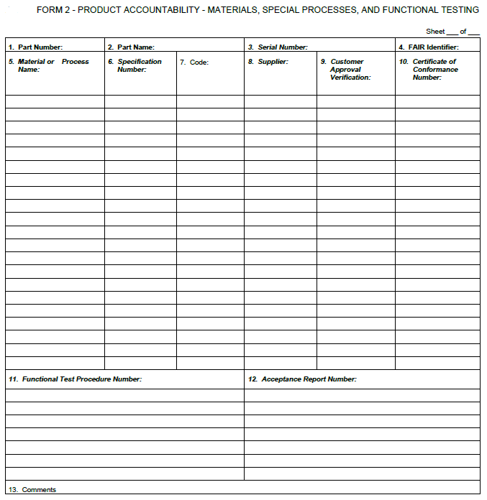
AS9102 First Article Inspection (FAI) Requirements
Submission - FAI Report packet contents
AS9102 forms
  FORM 2 - PRODUCT ACCOUNTABILITY - MATERIALS, SPECIAL PROCESSES, AND FUNCTIONAL TESTING
    Box 1 thru 4…always required
    Box 5 thru 12…required when materials, special processes or functional testing are defined as a design characteristic

Slide 16
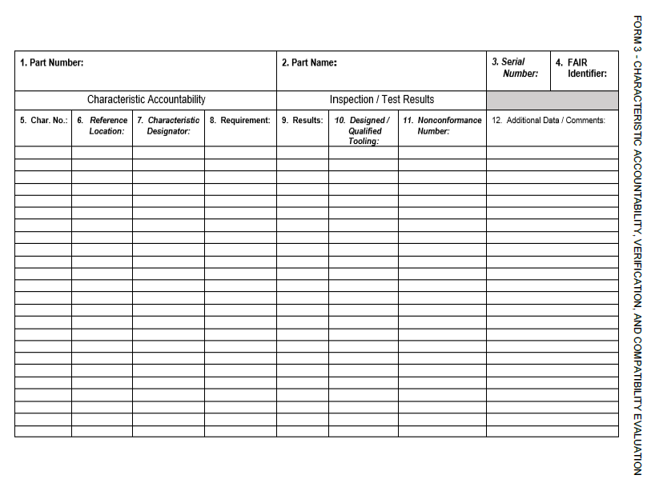
AS9102 First Article Inspection (FAI) Requirements
Submission - FAI Report packet contents
AS9102 forms
  FORM 3 - CHARACTERISTIC ACCOUNTABILITY, VERIFICATION, AND COMPATIBILITY EVALUATION
    Box 1 thru 9…always required
    Box 10 and 11…as applicable
    Box 12+…always required
      Must contain method of inspection

Slide 17
AS9102 First Article Inspection (FAI) Requirements
Submission - FAI Report packet contents
Ballooned Drawing
AS9102 forms
Raw material certs
Process certs…as applicable
Test data/results…as applicable
Waivers, deviations…as applicable

Slide 18
AS9102 First Article Inspection (FAI) Requirements
Submission - FAI Report packet contents
Raw material certs – detail entered on AS9102 form 2
Proof the raw material used for the FAI meets the specification noted on the OTTO drawing
Certificate of Conformance (CoC) issued by the mill/raw material producer
  Per OTTO Supplier Quality Manual, Supplier Quality Clause C101 and C102
    The raw material test report/cert packet shall clearly indicate
    1. The applicable material specification and revision level to which the material conforms
    2. Material heat, lot or batch number
    3. Name of mill/company that produced the material
    4. Other applicable technical data
    5. Complete material traceability (from the mill/raw material producer to OTTO)
    6. Manufacture date and shelf life/expiration date – if applicable
    OTTO recommends referring to the SQM for specific requirements per process cert

Slide 19
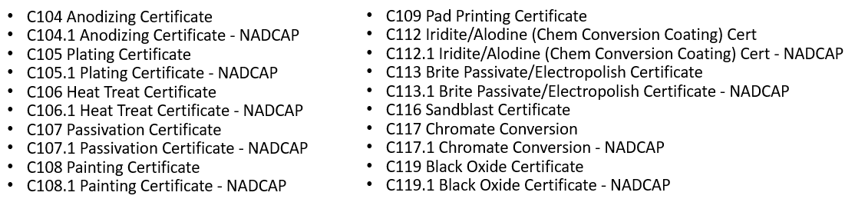
AS9102 First Article Inspection (FAI) Requirements
Submission - FAI Report packet contents
Process certs (i.e., paint, anodize, passivate) – detail entered on AS9102 form 2
Proof that special processing was correctly applied to the part/product
Certificate of Conformance (CoC) issued by the process supplier
    Per OTTO Supplier Quality Manual (SQM), applicable Supplier Quality Clauses
      OTTO recommends referring to the SQM for specific requirements per process cert

Slide 20
AS9102 First Article Inspection (FAI) Requirements
Submission - FAI Report packet contents
Ballooned drawing
AS9102 forms
Raw material certs
Process certs…as applicable
Test data/results…as applicable- detail entered on AS9102 form 2
  Test procedure number and test report required when functional testing is defined as a design characteristic
Waivers, deviations

Slide 21
AS9102 First Article Inspection (FAI) Requirements
Submission - FAI Report packet contents
Ballooned drawing
AS9102 forms
Raw material certs
Process certs…as applicable
Test data/results…as applicable
Waivers, deviations
  Include all applicable OTTO approved waivers and/or deviations
  December’s webinar will cover waivers and deviations

Slide 22
AS9102 Form 3
Characteristic Accountability, Verification and Compatibility Evaluation
Confidential

Slide 23
AS9102 First Article Inspection (FAI) Requirements
AS9102 FORM 3 - CHARACTERISTIC ACCOUNTABILITY, VERIFICATION, AND COMPATIBILITY EVALUATION
Dimensional Layout
  Box 12+…always required
  Must contain method of insp

Slide 24
AS9102 First Article Inspection (FAI) Requirements
FORM 3 - CHARACTERISTIC ACCOUNTABILITY, VERIFICATION, AND COMPATIBILITY EVALUATION
Includes inspection results for
  All variable (i.e., numeric) features such as linear dimensions, diameters, positions etc.
    Indicated by a +/- tolerance shown directly on the dimension
    Title block tolerance on the print applies
  All attribute (i.e., Pass/Fail or Yes/No) features such as part marking, appearance checks
  Each measurement must be traceable to the gage used and its calibration record
  Gages/measurement equipment used shall have adequate resolution (typically 1/10th of the tolerance of the feature being measured
Does NOT Include
  Basic dimensions
    By definition, a basic dimension is always equal to itself, so reporting a basic dimension is redundant
  Reference dimensions

Slide 25
AS9102 FAI Packet
How to Submit to OTTO
Confidential

Slide 26
AS9102 First Article Inspection (FAI) Requirements
Submission – AS9102 FAI Packet: where/how to submit
Email report to supplierquality@ottoexcellence.com prior to or in conjunction with shipping parts to OTTO
Alternate submission options (not preferred)
  Email to your OTTO buyer
  Include hard copy with shipment
  When including a hard copy with shipment, clearly label the outside of the carton that contains the AS9102 FAI packet with “Quality Documentation Enclosed”

Slide 27
Future Webinars
Confidential

Slide 28
Future Webinars
Root Cause Analysis and Corrective and Preventive Action (RCA/CAPA)…Nov
Waivers, Deviations, Permanent Change Requests…Dec
Supplier Scorecards…1st Qtr 2024
Reminder: Webinars are recorded and made available on the OTTO Website under Quality → Supplier Webinars

Slide 29
THANK YOU
Confidential

